Slide 1
A Technical Introduction to WiredTiger
Thanks for joining:
Michael Cahill
Director of Engineering (Storage), MongoDB
We’ll begin shortly.

Slide 2

About The Presenter
Michael Cahill
WiredTiger team lead at MongoDB
Sydney, Australia
michael.cahill@mongodb.com
@m_j_cahill

Slide 3
What You Will Learn
WiredTiger Architecture
In-memory performance
Document-level concurrency
Compression and checksums
Durability and the journal
What’s next?

Slide 4
This webinar is not…
How to write stand-alone WiredTiger apps
contact info@wiredtiger.com if you are interested
How to configure MongoDB with WiredTiger for your workload

Slide 5
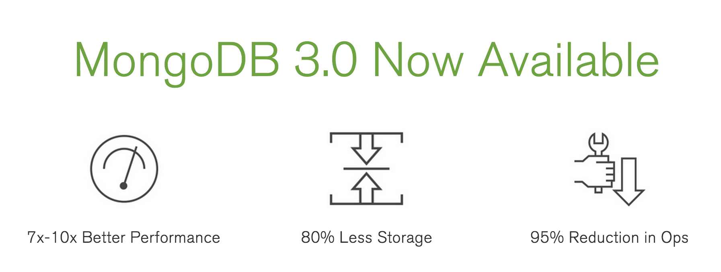
You may have seen this:

Slide 6
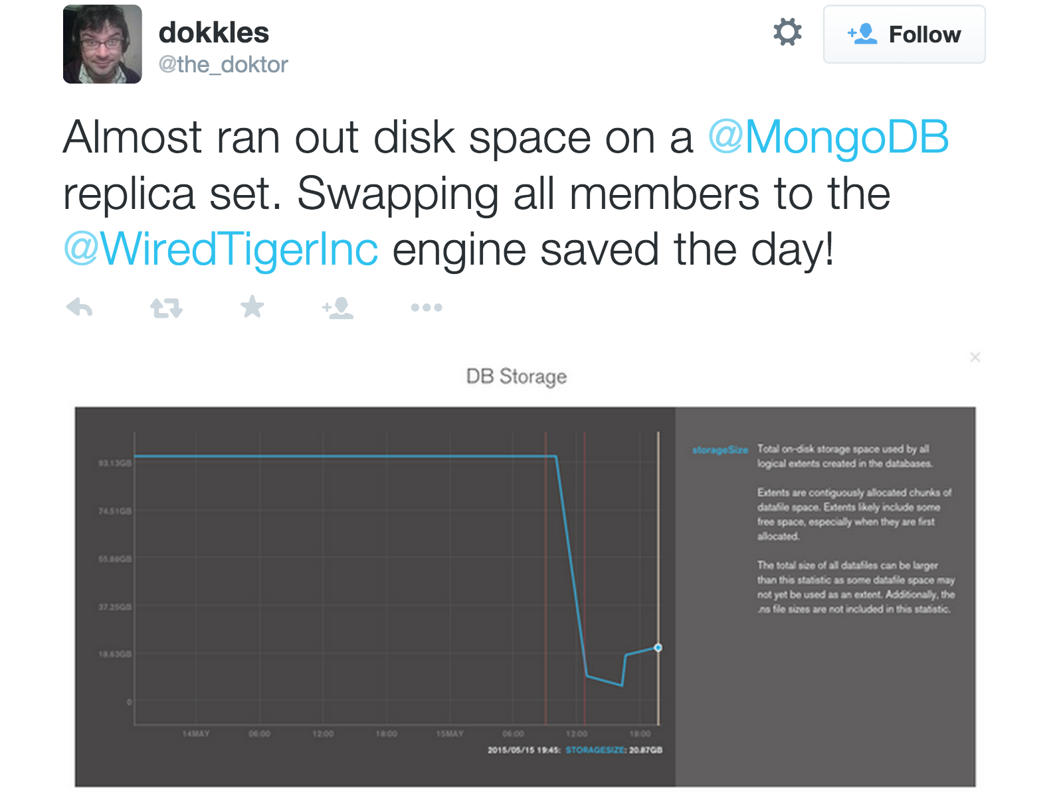
or this…

Slide 7
What You Will Learn
WiredTiger Architecture
In-memory performance
Document-level concurrency
Compression and checksums
Durability and the journal
What’s next?

Slide 8

MongoDB’s Storage Engine API
Allows different storage engines to "plug-in"
different workloads have different performance characteristics
mmap is not ideal for all workloads
more flexibility
mix storage engines on same replica set/sharded cluster
MongoDB can innovate faster
Opportunity to integrate further (HDFS, native encrypted, hardware optimized …)
Great way for us to demonstrate WiredTiger’s performance
Notes:
<Exciting, good fit for lots of MongoDB workloads>

Slide 9
Storage Engine Layer
Example Future State
Content Repo
IoT Sensor Backend
Ad Service
Customer Analytics
Archive
MongoDB Query Language (MQL) + Native Drivers
Security
MongoDB Document Data Model
Management
MMAP V1
WT
In-Memory
?
?
Supported in MongoDB 3.0
Experimental
Future Possible Storage Engines

Slide 10
Motivation for WiredTiger
Take advantage of modern hardware:
many CPU cores
lots of RAM
Minimize contention between threads
lock-free algorithms, e.g., hazard pointers
eliminate blocking due to concurrency control
Hotter cache and more work per I/O
compact file formats
compression

Slide 11
WiredTiger Architecture

Slide 12
What You Will Learn
WiredTiger Architecture
In-memory performance
Document-level concurrency
Compression and checksums
Durability and the journal
What’s next?

Slide 13
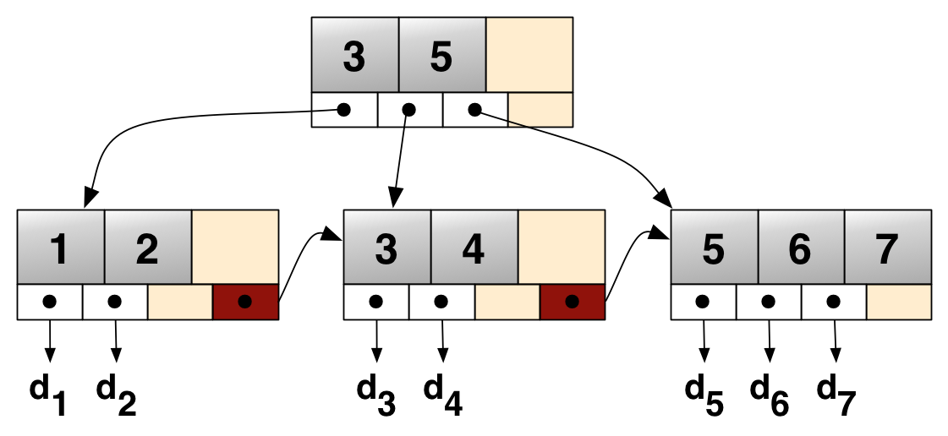
Traditional B+tree (ht wikipedia)

Slide 14
Trees in cache

Slide 15
Hazard Pointers
1 memory flush

Slide 16
Pages in cache
Notes:
Different in-memory representation vs on-disk – opportunities to optimize plus some interesting fetures
Writing a page:
Combine the previous page image with in-memory changes
Allocate new space in the file
If the result is too big, split
Always write multiples of the allocation size
Can configure direct I/O to keep reads and writes out of the filesystem cache

Slide 17
In-memory performance
Trees in cache are optimized for in-memory access
Follow pointers to traverse a tree
no locking to access pages in cache
Keep updates separate from clean data
Do structural changes (eviction, splits) in background threads

Slide 18
What You Will Learn
WiredTiger Architecture
In-memory performance
Document-level concurrency
Compression and checksums
Durability and the journal
What’s next?

Slide 19
What is Concurrency Control?
Computers have
multiple CPU cores
multiple I/O paths
To make the most of the hardware, software has to execute multiple operations in parallel
Concurrency control has to keep data consistent
Common approaches:
locking
keeping multiple versions of data (MVCC)

Slide 20
WiredTiger Concurrency Control

Slide 21
Pages in cache
skiplist
Notes:
Different in-memory representation vs on-disk – opportunities to optimize plus some interesting fetures
Writing a page:
Combine the previous page image with in-memory changes
Allocate new space in the file
If the result is too big, split
Always write multiples of the allocation size
Can configure direct I/O to keep reads and writes out of the filesystem cache

Slide 22
Multiversion Concurrency Control (MVCC)
Multiple versions of records kept in cache
Readers see the committed version before the transaction started
MongoDB “yields” turn large operations into small transactions
Writers can create new versions concurrent with readers
Concurrent updates to a single record cause write conflicts
MongoDB retries with back-off

Slide 23
MVCC In Action
update
update

Slide 24
What You Will Learn
WiredTiger Architecture
In-memory performance
Document-level concurrency
Compression and checksums
Durability and the journal
What’s next?

Slide 25
WiredTiger Page I/O

Slide 26
Trees in cache
read required

Slide 27
Pages in cache
reconciled during write
Notes:
Different in-memory representation vs on-disk – opportunities to optimize plus some interesting fetures
Writing a page:
Combine the previous page image with in-memory changes
Allocate new space in the file
If the result is too big, split
Always write multiples of the allocation size
Can configure direct I/O to keep reads and writes out of the filesystem cache

Slide 28
Checksums
A checksum is stored with every page
Checksums are validated during page read
detects filesystem corruption, random bitflips
WiredTiger stores the checksum with the page address (typically in a parent page)
extra safety against reading a stale page image

Slide 29

Compression
WiredTiger uses snappy compression by default in MongoDB
Supported compression algorithms:
snappy [default]: good compression, low overhead
zlib: better compression, more CPU
none
Indexes also use prefix compression
stays compressed in memory

Slide 30
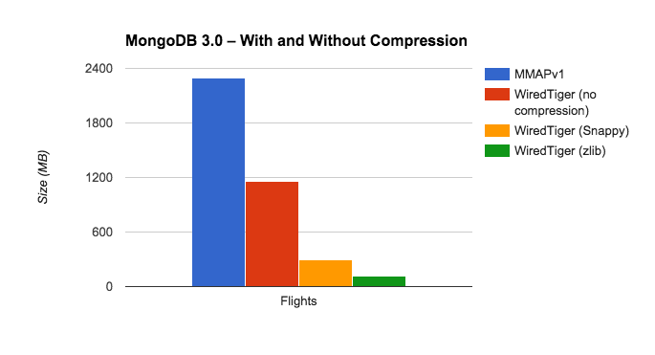
Compression in Action
(Flights database, ht Asya)

Slide 31
What You Will Learn
WiredTiger Architecture
In-memory performance
Document-level concurrency
Compression and checksums
Durability and the journal
What’s next?

Slide 32
Journal and Recovery
Write-ahead logging (aka journal) enabled by default
Only written at transaction commit
Log records are compressed with snappy by default
Group commit for concurrency
Automatic log archive / removal
On startup, we rely on finding a consistent checkpoint in the metadata
Use the metadata to figure out how much to roll forward

Slide 33
Durability without Journaling
MMAPv1 require the journal for consistency
running with “nojournal” is unsafe
WiredTiger doesn't have this need: no in-place updates
checkpoints every 60 seconds by default
with “nojournal”, updates since the last checkpoint may be lost
data will still be consistent
Replication can guarantee durability

Slide 34
Writing a checkpoint
Write dirty leaf pages
don’t overwrite, write new versions into free space
Write the internal pages, including the root
the old checkpoint is still valid
Sync the file
Write the new root’s address to the metadata
free pages from old checkpoints once the metadata is durable

Slide 35
Checkpoints in Action

Slide 36
Checkpoints in Action (cont.)

Slide 37
What You Will Learn
WiredTiger Architecture
In-memory performance
Document-level concurrency
Compression and checksums
Durability and the journal
What’s next?

Slide 38
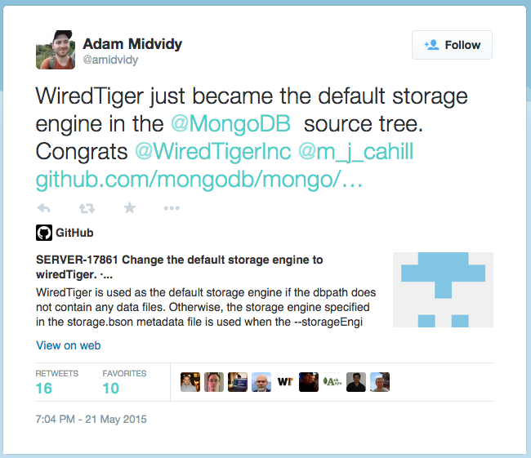

Slide 39
WiredTiger LSM support
Out-of-order insert workloads
Data set much larger than cache
Query performance is not (as) important
Resource overhead of background maintenance acceptable

Slide 40
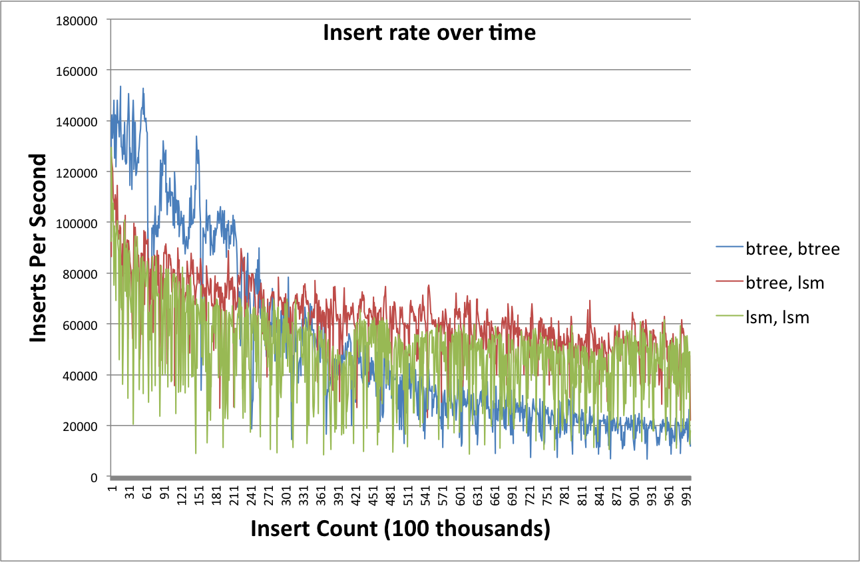

Slide 41
What’s next for WiredTiger?
Tune for (many) more workloads
avoid stalls during checkpoints with 100GB+ caches
make capped collections (including oplog) more efficient
Mark Callaghan seeing ~2x speedup in 3.1 snapshots: http://smalldatum.blogspot.com/
Make Log Structured Merge (LSM) trees work well with MongoDB
out-of-cache, write-heavy workloads
Adding encryption
More advanced transactional semantics in the storage engine API

Slide 42
Thanks! Questions?
Michael Cahill
michael.cahill@mongodb.com

